Slide 1
Digital Portfolio
STUDENT NAME:K Janani
REGISTER NO AND NMID: asunm189222403105
DEPARTMENT: Bsc Computer science
COLLEGE: COLLEGE/ UNIVERSITY: CSI EWART WOMEN'S CHRISTIAN COLLEGE MELROSAPURAM MADRAS UNIVERSITY

Slide 2
PROJECT TITLE
Planting portfolio

Slide 3


AGENDA
Problem Statement
Project Overview
End Users
Tools and Technologies
Portfolio design and Layout
Features and Functionality
Results and Screenshots
Conclusion
Github Link
3/21/2024 Annual Review

Slide 4

PROJECT STATEMENT: The project emphasizes sustainable practices, biodiversity, and climate-appropriate planting choices, ensuring that the portfolio not only reflects artistic design but also ecological responsibility. By combining visual layouts, plant specifications, seasonal planning, and photographic documentation, the planting portfolio provides a comprehensive reference tool for students, professionals, and gardening enthusiasts.

Slide 5

PROJECT OVERVIEW: This portfolio acts as a visual and technical record, showcasing knowledge of horticultural practices, eco-friendly methods, and the role of plants in improving biodiversity, air quality, and overall well-being. It is designed to serve as a reference guide for students, professionals, and anyone interested in gardening .

Slide 6

WHO ARE END USERS: 1. Landscape Architects & Designers – to plan and present planting layouts for projects. 2. Horticulture Students & Researchers – as a learning and reference tool. 3. Gardeners & Plant Enthusiasts – for inspiration and practical guidance. 4. Urban Planners & Environmentalists – to integrate green spaces in cities sustainably.

Slide 7

TOOLS AND TECHNIQUES:1. Design & Layout Tools – Sketching tools, AutoCAD, Photoshop, or digital design apps. 2. Documentation Tools – Camera for plant growth photos, notebook/journal, MS Word/PowerPoint/Canva for portfolio design. 3. Gardening Tools – Spade, trowel, pruning shears, watering can, rake, hoe, gloves. Plant Selection Techniques – Choosing plants based on soil type, climate, season, and purpose. 2. Design Techniques – Symmetrical, asymmetrical, cluster, or layered planting. 3. Color & Texture Planning – Combining plants for visual harmony (contrast, repetition, balance).

Slide 8
POTFOLIO DESIGN AND LAYOUT: 1. Cover Page – Title, Name, Class, Year, Plant Image/Sketch.
2. Table of Contents – List of sections.
3. Introduction / Problem Statement – Why the project is important.
8

Slide 9
FEATURES AND FUNCTIONALITY : 🔹 Features Cover & Design – Attractive eco-friendly layout with title, images, and student details. Systematic Sections – Introduction, objectives, tools, methodology, observations, and results.

Slide 10
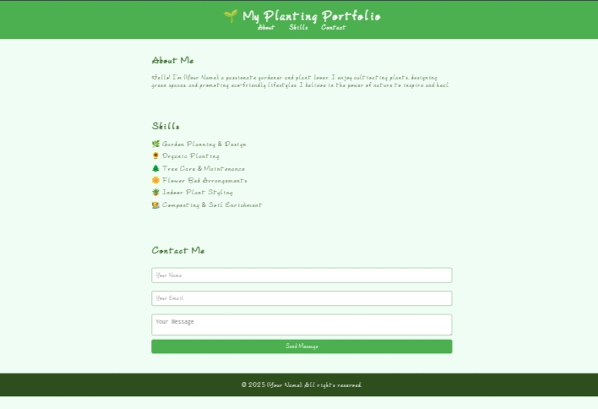

Result and screenshort:
3/21/2024 Annual Review
10

Slide 11
CONCLUSION
Planting is a vital practice that supports the environment, provides food, improves air quality, and enhances the beauty of surroundings. It plays a key role in sustaining life and creating a healthier future.
11

